Slide 1
The ChapR Presentation

Slide 2
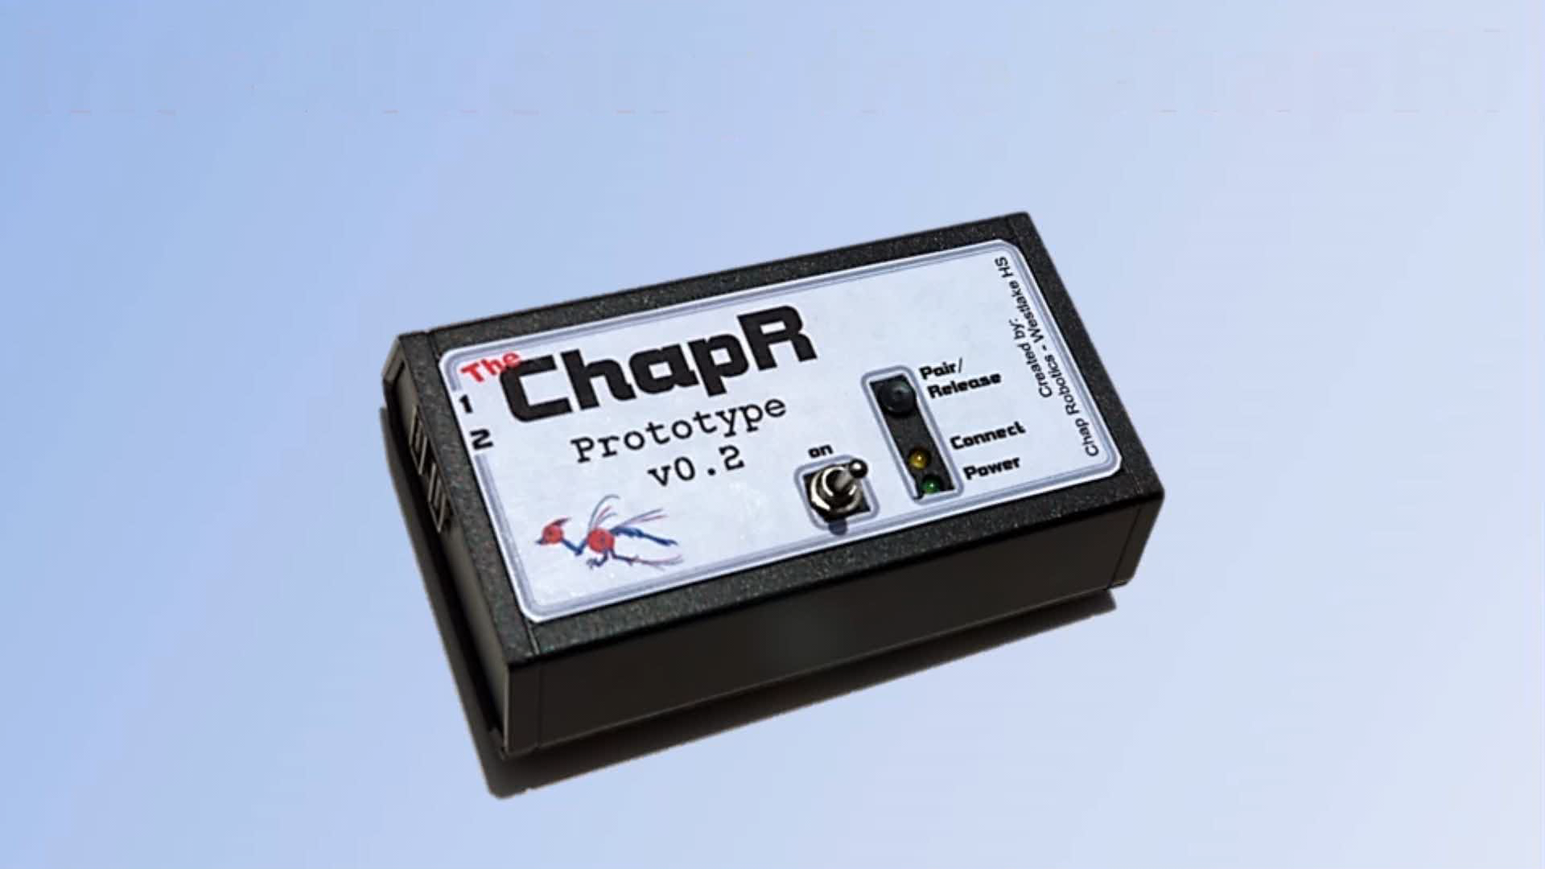

Slide 3
What is the ChapR?
A remote for translating USB “joystick” input to BT for controlling robots
A way around RobotC/LabView/NXT-G to quickly run programs

Slide 4
Why is it good?
Convenient way of testing
Patent for WESTA
Spreading STEM
Something to talk about for awards
Service hours and experience for Westlake students making ChapRs
Spreading the name of Westlake Robotics and every 4th ChapR is given to a team in need for free

Slide 5
Plan
Buy parts for 10 ChapRs (20 boards have been ordered)
Set up 3 soldering stations and train 6 people to solder boards (3 of which would be the ChapR team)
Get back in touch with the people who initially showed interest
Send a ChapR to Irad Allen at VHS and David Calkins at Lego Education
Keep in touch with the beta testers and fix bugs if necessary
Give 4 ChapRs to Westlake

Slide 6
What do we need?
$450 total for 3 soldering stations
$1125 total for 15 ChapRs at cost
5 to reimburse Coach Eric
10 to build new ChapRs
$1125 will be returned after the sale of the ChapRs (minus the 4 that go to Westlake)
A 501c3 nonprofit organization to accept funds

